Slide 1
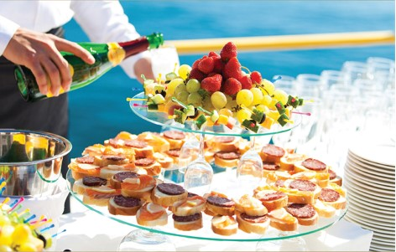
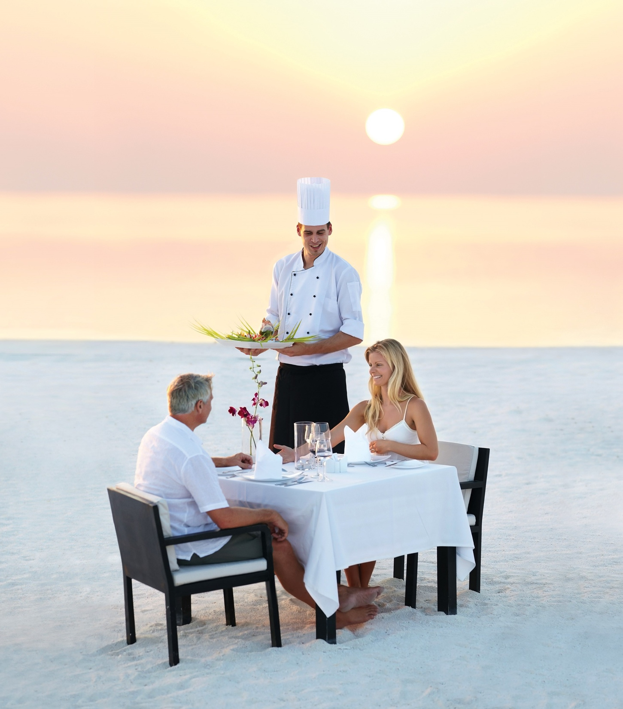

Chapter 8
Providing customer service through the servicescape
Introduction to customer service
© Hudson & Hudson. Customer Service for Hospitality & Tourism 3rd edn

Slide 2
Topics Covered
Elements of the servicescape
The strategic role of the servicescape
Developing servicescapes
The effects of servicescapes on consumer behaviour
Waiting line strategies
COVID-19 and the servicescape

Slide 3
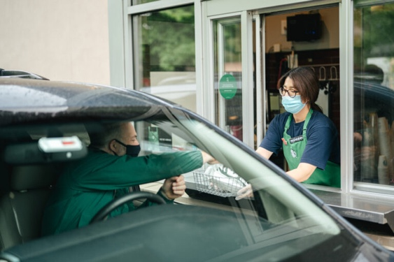
‘At Your Service’ Spotlight:
Hospitality Starbucks-style
‘Third place’ - a social, yet personal environment ….where people connect with others and reconnect with themselves.
Themes inspired by Italian espresso bars
  Inviting, comfortable, compelling servicescapes
  Sensory pleasures and ambiance
  Italian terminology
Customer focused
  First names on paper cups
  Free WiFi for work, social networking
  Meeting place, community hub
Long-term brand integrity
  Espresso machines replaced
  Modified menu items
  Slowed expansion, new products
During the COVID-19 pandemic, and Starbucks was one of the first US chains to convert the vast majority of its sales to drive-through and delivery mediums.

Slide 4
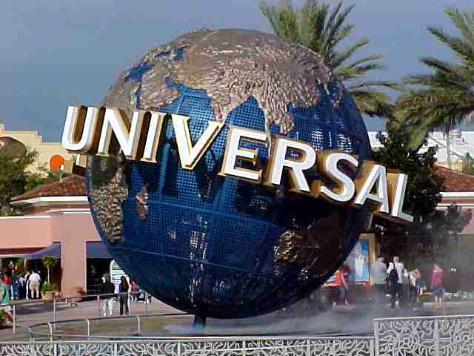
Key characteristics of the servicescape
Physical environment often referred to as the ‘servicescape’
  Facilitates performance or communication of service
Particularly important for tourism & hospitality products
Universal for example effectively uses the servicescape to excite customers
Notes:
Key characteristics of the servicescape
Physical environment often referred to as the ‘servicescape’
Facilitates performance or communication of service
Particularly important for tourism & hospitality products
Universal for example effectively uses the servicescape to excite customers

Slide 5
Elements of the servicescape
Table 8.1

Slide 6
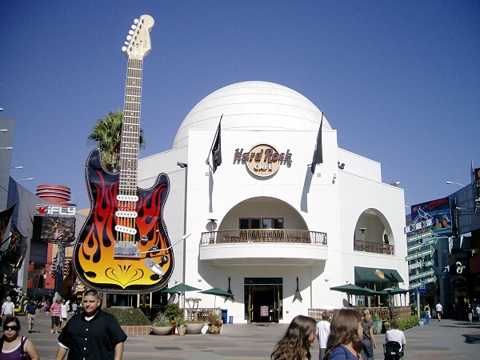
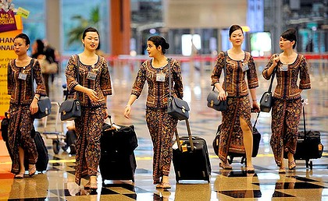
The strategic role of the servicescape
Packaging
  Creates external image
  Sets expectations
Facilitator
  Aids performances of service providers
  Physical layout and functional design
Socializer
  Suggests expected roles, behaviors and relationships
Differentiator
  Distinguished from competitors
  Signals appropriate market segments

Slide 7
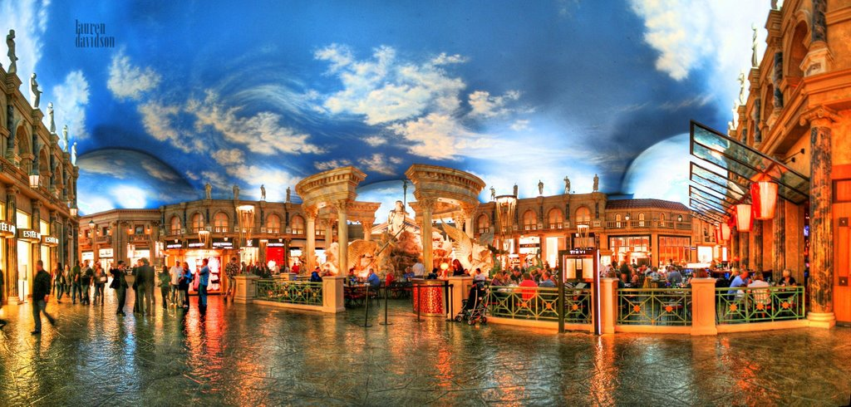
Developing servicescapes
Effective servicescapes:
  Have to be seen holistically
  Everything depends on everything
  e.g. scent and music work together
Themed servicescapes common these days (e.g. Forum Shops)
Interactive servicescapes (e.g. Churchill Museum)
Servicescapes developed to attract new market segments

Slide 8
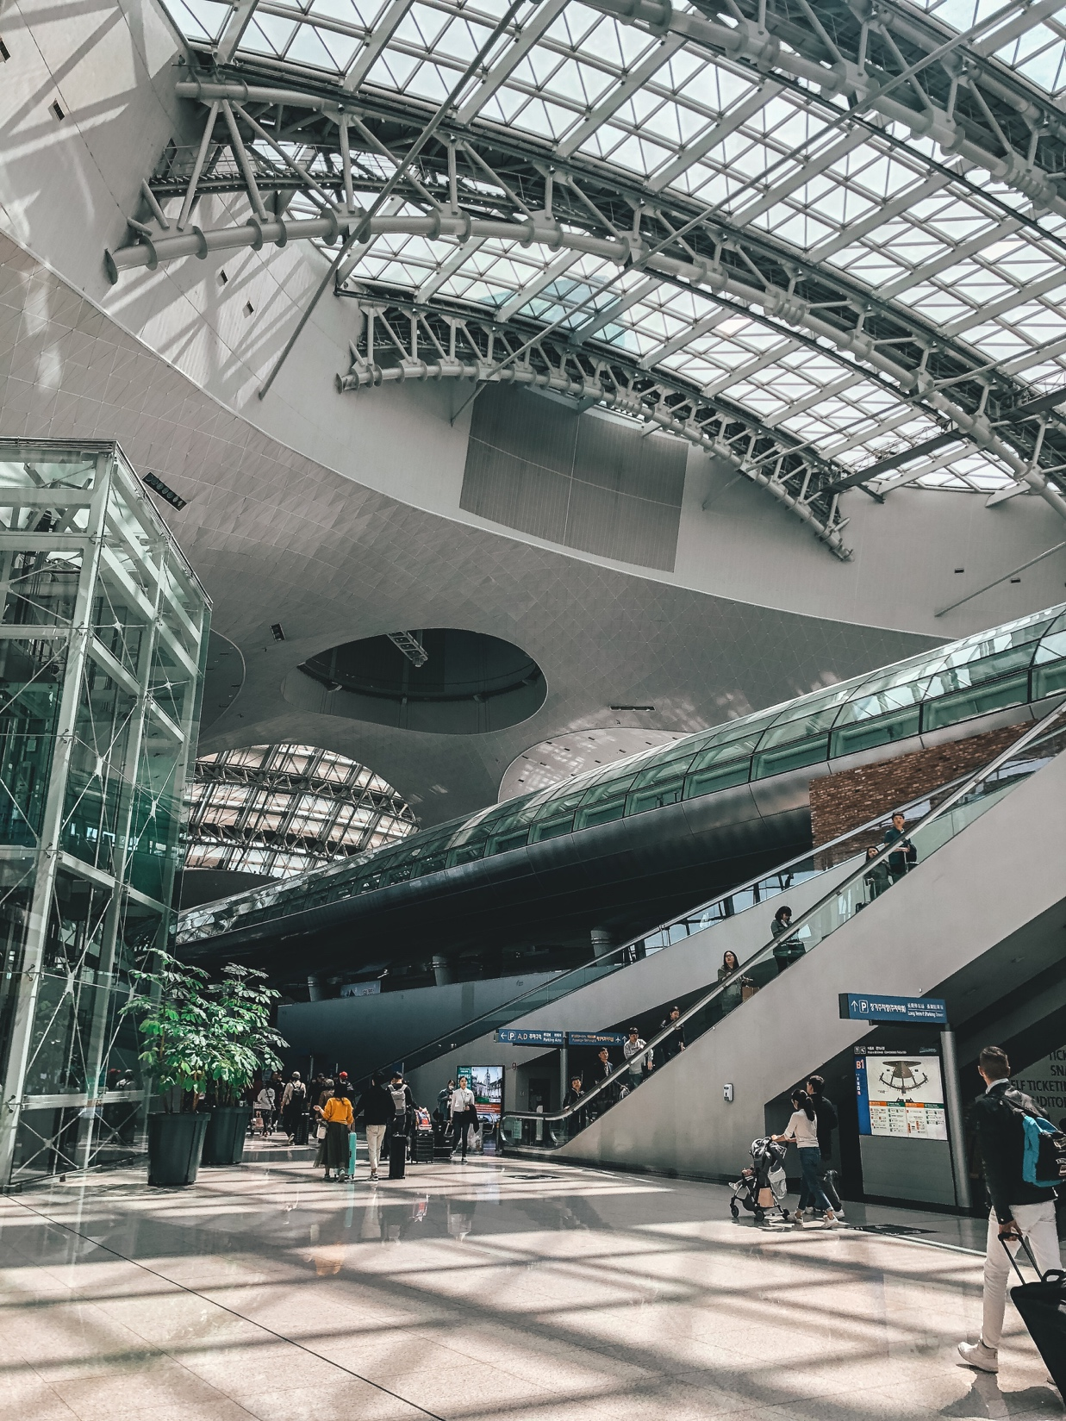
Snapshot:
Incheon Airport, Korea
Customer transit services
  Fast processing times, interactive LCD info screen
  Multi-lingual staff and signage
Customer amenities
  Free internet access, computers, showers, changing rooms
  Between flight tours, golf outings
  Shops, food courts, lounges, cultural centers
Staff training and improvement
  ICAO training center
  Service Improvement Committee
  Incentive program
Technological innovations
  Cooperation and data sharing
  Passenger number forecasting
“As the aviation industry continues to navigate the COVID-19 pandemic and prepares to support a sustained recovery, meeting the changing needs and expectations of customers will be ever more important”

Slide 9
The effects of servicescapes on consumer behaviour
Customers loyalty incentives:
  High perceived value
  ‘Get’ should exceed ‘Give’
  Rewards for loyalty
Company benefits:
  Higher profits through retaining customers
    More purchases overall
    More frequent purchases
  Lowers operating costs
    No acquisition costs
  Increases company referrals

Slide 10
How the servicescape impacts consumers and employees
Figure 8.1 (Source: Adapted from Bitner, 2002)

Slide 11
Common associations and human responses to colors
Table 8.2 (Source: Based on Lovelock and Wirtz, 2007)

Slide 12
Waiting line strategies – 4 strategies
Employ operational logic
  Streamline operational processes
  Eliminate inefficiencies
  Queue configuration
Establish a reservation system
  Shift demand to time less busy periods
  Inherent problem of ‘no-shows’
    Charge fee
    Overbook capacity
Differentiate waiting customers
  Need-based or customer priority
  Guest registering e.g. FASTPASS
Make waiting time more fun, or at least tolerable

Slide 13
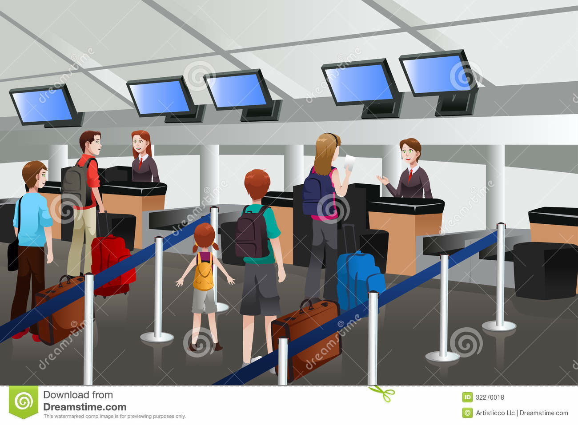
Three possible queue configurations

Slide 14
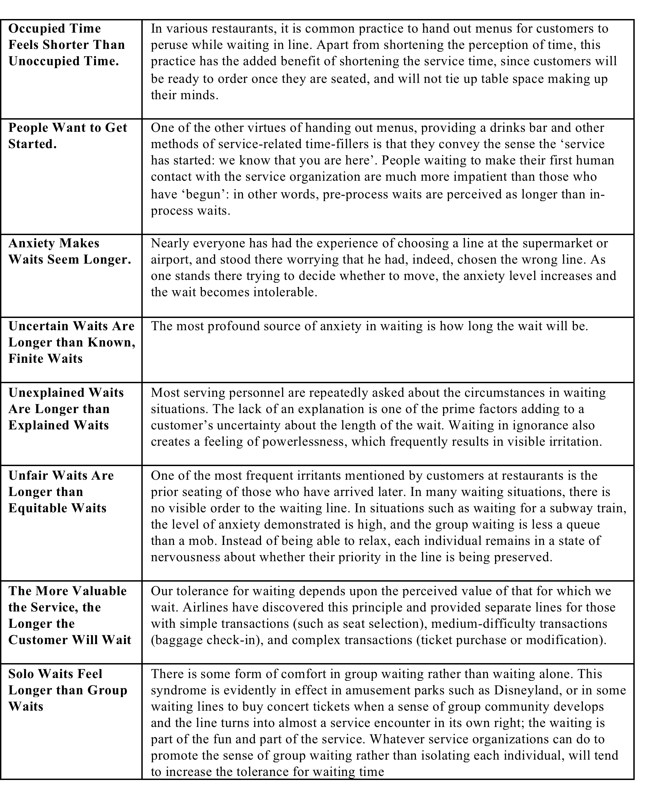
The psychology of waiting lines (Maister)

Slide 15
COVID-19 and the Servicescape
After the COVID-19 crisis, all sectors of the travel industry had to rethink – and often redesign – their servicescapes.
Visitor management of outdoor spaces became a priority for many destinations.
Servicescapes indoors were sometimes not as easy to redesign in order to ensure appropriate distancing.
Hotel design may undergo significant changes post COVID-19 pandemic.

Slide 16
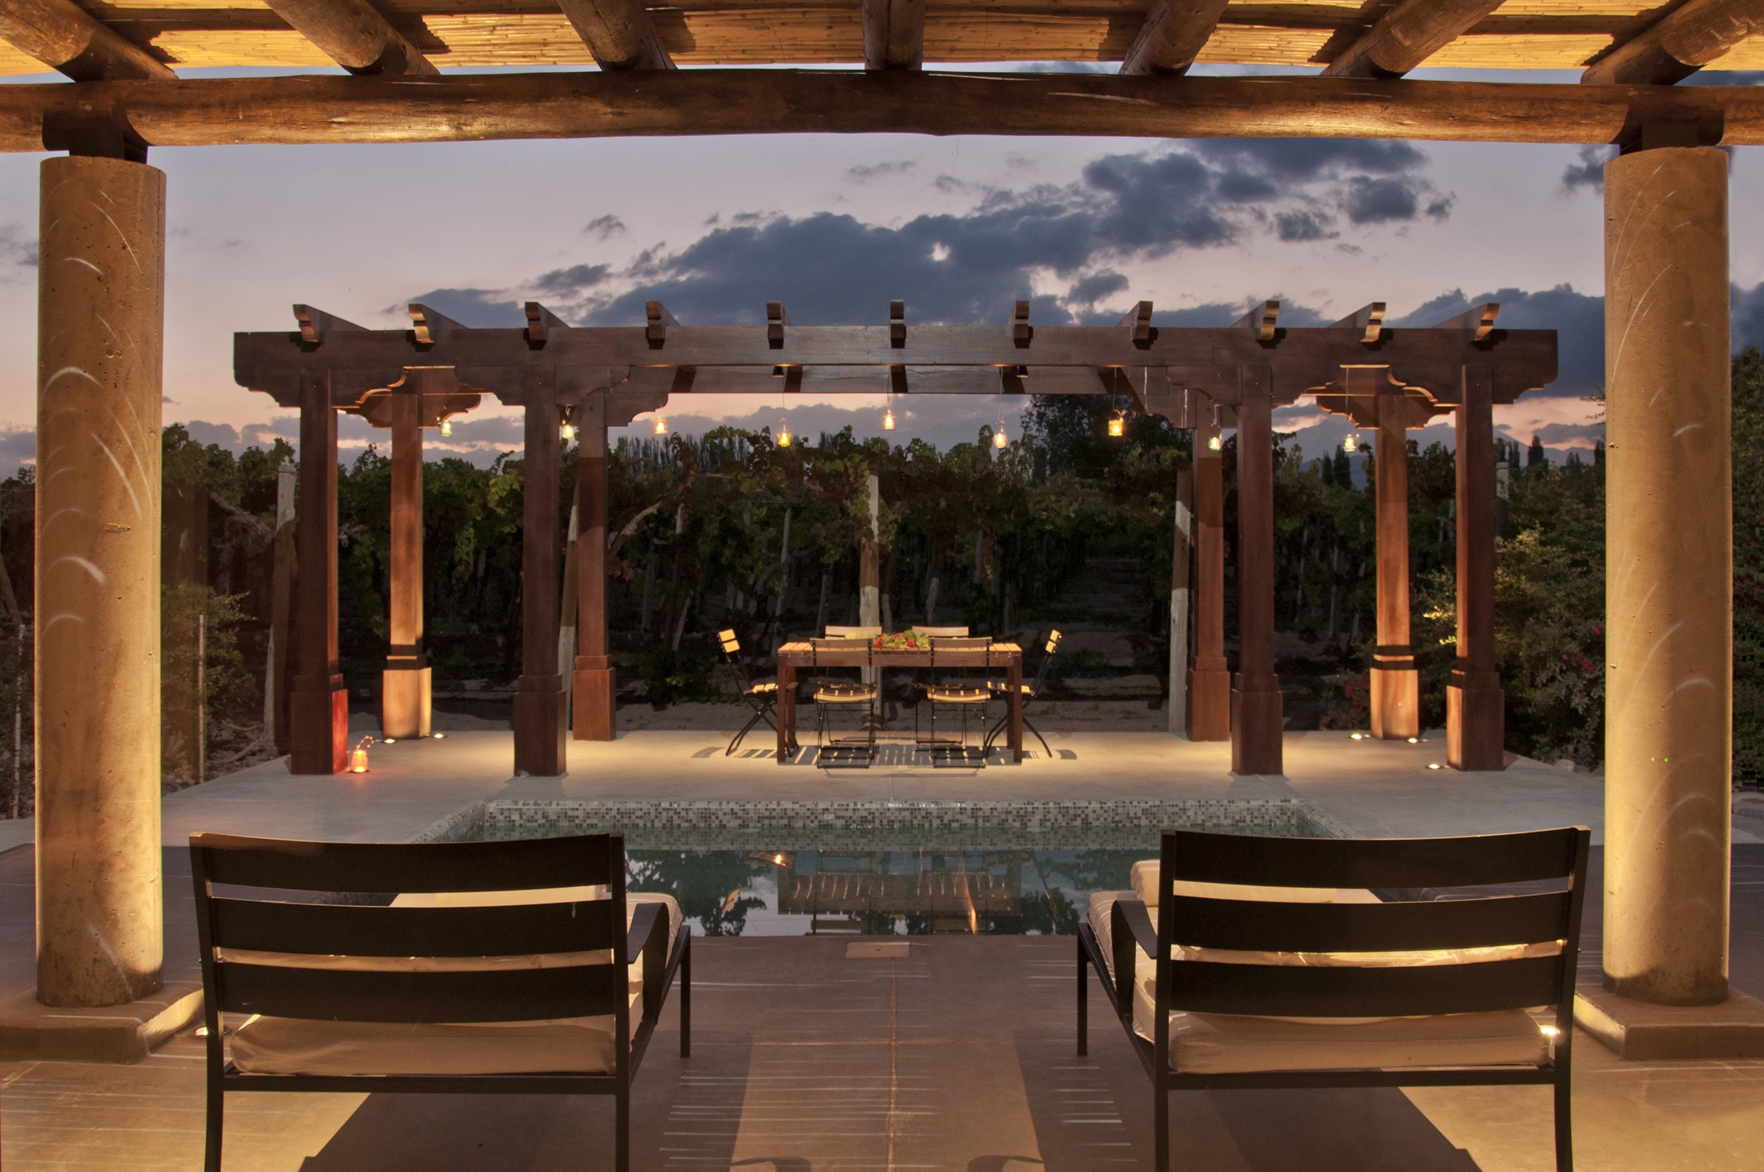
Case Study:
Attention to Detail at Cavas Wine Lodge
We seek the best experience, effortless for our guests.
Exterior design complements landscape
Interior design:
  Unique décor, color schemes
  Mood enhancing music, atmospheric lighting, “clean and fresh” smell
  Hand-selected objects, furniture by local craftsmen, artists
  Regional, organic fruit and vegetables
Customer service
  Staff uniforms
  Frontline service
  Guest expectations
  Surprise events e.g.
  tango evenings
  outdoor cooking lessons

